Slide 1

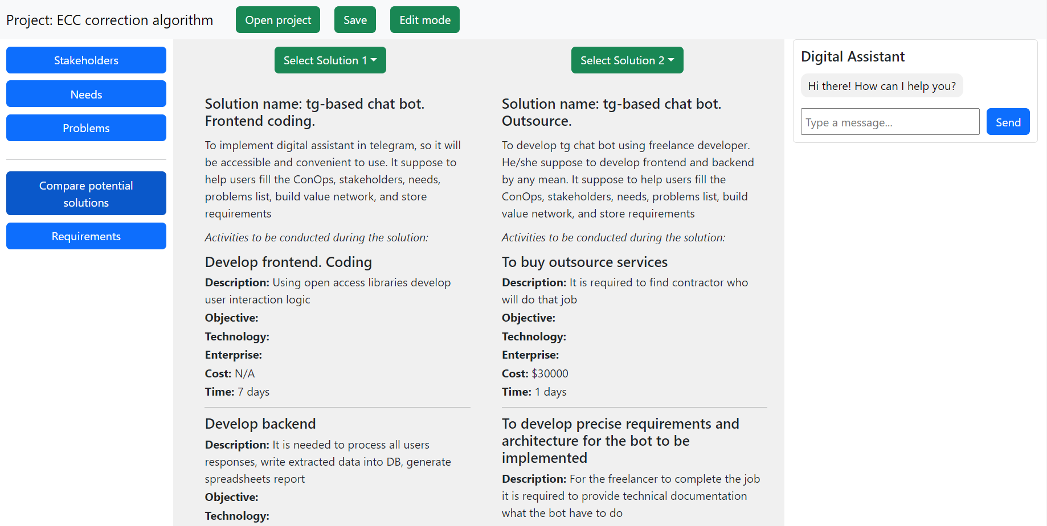
Designing knowledge base model representing a multi-scenario CONOPS of SoS
Valentin Tikhonenko, Valentin.Tikhonenko@skoltech.ru, +7 995 234 7929
Engineering Systems
Mikhail Belov
IT_one, a leading software engineering company, provides digital solutions as well as develops its own products.
The idea was to create a service incorporating system engineering practices to enhance development team performance. This service shall digitize the Concept of Operation (ConOps) document, which offers a high-level vision of the future system operation, eliciting requirements from various stakeholders. It should store all the data, support relations, generate the report.
Develop information model of ConOps
To develop feasible prototype for the service with designed information model
Iterate continuously improving UI and functionality, since the instrument is quite new to the market and high level of uncertainty is prominent.
The work process was organized in iterative manner: each week there was check-up meeting to discuss work done, problems and questions, also week reports were required.
I were developing the project by myself, but had extensive support from supervisor and other IT_one employees.
During development process stakeholders feedback session were conducted, where new functionality and features required within the product were elicited.
Web service was developed using:
strapi – backend content management system
gatsby – Javascript based frontend library
Bootstap – css components library
Stakeholders
Development team
Environment
Compare solutions
Potential solutions development
The Service
Clients need
Stakeholders
definition
Need/problems elicitation
Requirements elicitation
Pic. 1 – Developed service model
Ready-to-use prototype was developed.
Important notes discovered during feedback sessions:
Stakeholders problems and needs entities are required both, since depending on the case, one or another might be easier to elicit.
ConOps might be represented as the set of solution for the initial need (or problem);
Each solution represented as set of activities required to implement it;
Each activity has objective, its own technologies and enterprises (contractors or company’s divisions) involved, as well as time and cost required. Activity might be represented with hierarchy;
To facilitate user’s work flow in the service it is required to implement digital assistant capable of answering questions from local knowledge base.
Pic. 2 – Service user interface
This project delivered the service that helps during concept developments stage. In future, those features and functionalities elicited during the immersion project are planned to be implemented in full-scale product.
Future work might be to develop digital assistant that incorporates system engineering and private company’s knowledge to guide user through the ConOps development process.
Special thanks to Maxim S. for his advises during development process and Anton V. for the help in CI/CD and server deployment.

